Slide 1
State intervention in transport market regulation
Kati Nõuakas, 2022

Slide 2
Headline
Interreg Central Baltic Project: INTELTRANS – Intelligent Transport and Traffic Management study module, 2020-2022.
The transport system of the Central Baltic area is in need of better integration in order to take into account the mobility needs of the whole CB region. We need to increase traffic safety, efficiency, mobility and customer satisfaction across national borders, while reducing environmental impact. The project aims to contribute towards transport system that is safe, resilient, seamless and environmentally friendly for citizens, companies and society as a whole. To achieve this goal, project partners want to modernize transport and traffic management professional higher education (VET) curricula, learning processes, and learning environments.
In the effort of harmonizing transport curricula we must take into account new insights and demands connected with transport infrastructure, driver behaviour, as well as both the physical and general business environment. Globally new technologies for vehicles are coming and traffic management will be key to handle negative impact of transport. The project partners, universities of applied sciences, address emerging development needs by creating a joint Intelligent Transport and Traffic Management study module (15 ECTS) and pilot it with multinational groups of students, together with methodology and materials that are applicable and replicable outside current partnership.

Slide 3
Road transport role in EU (1):
Important sector of the EU economy
It contributes to economic growth and plays a vital role
mobile society, in moving people and goods
it provided employment to over 11 million people – more than 5 % of the EU's workforce
Roads are the main mode of inland passenger and freight transport in the EU and, despite attempts to shift traffic to other modes of transport, are likely to remain so for the foreseeable future.
Building roads and making them more accessible is important for stimulating economic growth.

Slide 4
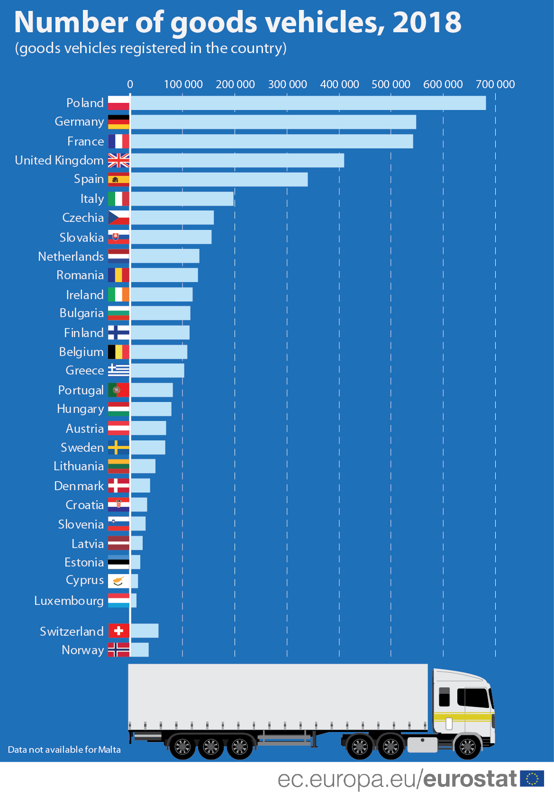
Road transport role in EU (2):
the EU's road network is incomplete
For example, the Member States in Central and Eastern Europe are not well served by east-west connections, nor are they well linked to each other.
While connections have improved in recent decades, notably with the help of EU funding, some links are still missing.

Slide 5
Share of road freight transport in total revenues from transport in respective EU Member States

Slide 6
Reasons of Government Intervention in Transportation Industry:
The ‘public good’ or non-commercial nature of urban transport;
Natural monopolies in public transport;
Safety regulation;
Environmental and health effects;
Providing access to the transport disadvantaged.

Slide 7
Transport as public good:
derived demandas
a link between the different links in the supply chain
need to move
increasing consumption and mobility needs of people
economic "circulation„
public transport as part of the transport market
the state can regulate the market, such as free public transport

Slide 8
Main Transport Policy Instruments:

Slide 9
Policy Instruments (1):
Governments have a large number of instruments at their disposal to carry out transport policy. Some are direct, such as public ownership, but the majority are indirect, such as safety standards. The most common are:
A vital instrument concerns public ownership. The direct control by the state of transportation infrastructure, modes, or terminals is widespread. Most common is the provision by public agencies of transport infrastructure such as roads, ports, airports, and canals. Public ownership also extends to include the operation of transport modes such as airlines, railways, ferries, and urban transit by public agencies.
Subsidies represent an important instrument used to pursue policy goals. Many transport modes and services are capital intensive, and thus policies seeking to promote services or infrastructure that the private sector is unwilling or unable to provide may be made commercially viable with the aid of subsidies.
Most public transit systems are subsidized to provide mobility since full cost recovery would make fares unaffordable to the poorer segments of the population. Both public ownership and subsidies represent instruments that require the financial involvement of governments. Revenue generation is becoming an increasingly important instrument in transport policy.

Slide 10
Policy Instruments (2):
Regulatory control represents a means of influencing the shape of transportation that is widely employed. By setting up public agencies to oversee particular sections of the transport industry, governments can influence the entire character and performance of the industry. The agencies may exert control on entry and exit, controlling which firms can offer transportation services, at what prices, to which markets. Environmental regulations are also important factors shaping the provision, construction, maintenance, and operation of transportation infrastructures. Thus, while private firms may offer the actual services, the regulator plays a determining role. Regulatory agencies in the US, such as the Civil Aeronautics Board, played a critical role in shaping the US airline industry for decades.
Many governments are major promoters of research and development in transportation. Government research laboratories are direct products of state investments in R&D, and much university and industry R&D is sustained by government contracts and programs. The outcomes of this research are extremely important to the industry. It is a vital source for innovation and the development of new technologies. Besides, educational institutions that are commonly funded by public resources provide operators, managers, and analysts for the private transport sector.

Slide 11
Policy Instruments (3):
Labor regulations pertaining to conditions of employment, training, and certification may not be directed purposefully at influencing transport. Still, as a policy, they may exert a significant effect on the industry since it has an impact on its operating costs.
Safety and operating standards, such as speed limits, may have a similar effect. The restrictions on limiting the number of hours a truck driver may work may be instituted for safety reasons and for enhancing the working conditions of drivers. Still, they shape the economics of truck transport. In the same fashion, speed limits help fix the distance of daily trips that one driver may undertake, thereby shaping the rate structure of the trucking industry.

Slide 12
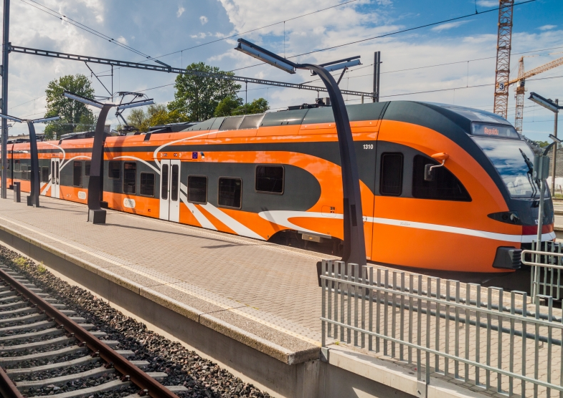
Policy Development:
Historical examples of private provision include:
Turnpikes
Canals
Urban transit
Ships
Railways

Slide 13
Changing Nature of Policy Interventions:
Controls over monopoly power are still in place, and even in the most liberal of economies, there is still strong evidence of public policy intervention:
Ownership of ports and airports. Terminals continue to be largely under State or municipal ownership, but concession agreements to private operators are common.
Highway provision, upgrade, and maintenance remain one of the most significant and enduring commitments of public funds.
Urban transit systems remain dominantly publicly owned and operated. Intercity transport is mostly private, which brings the question about if urban transportation would gain to be privatized.
Mergers and acquisitions between large private or public entities in the transport sector are commonly subject to regulatory approval.

Slide 14
Example-Free public transport in Estonia in Tallinn:
From the beginning of January 2013, Tallinn is the first capital in the EU to provide free public transport to its citizens.
To be entitled to freely use public transport in Tallinn, citizens of Tallinn have to purchase the so-called ‘green card’ (EUR 2) and personalise it. People from outside Tallinn can also buy the ‘green card’ which enables them to load the needed amount of money to use public transport.
Since the implementation of free public transport, a significant increase of the number of registered Tallinners can be observed.

Slide 15
For discussion- Estonia’s free county public transport did not fulfill goals (1):
The National Audit Office of Estonia have been investigating (2021) the free public transport introduced in Tallinn, including the free bus and tram travel for local registered people. Analysis included studying whether economic feasibility as well as the mobility needs of people had been taken into account when deciding to cut payment by users.
Results on the county model were that free public transport has not reached its goal to reduce car journeys. Whilst public transport use numbers have increased, still more than half of all trips to work are done by car.

Slide 16
For discussion (2):
The National Audit Office recommends that the responsible Minister of Economic Affairs and Infrastructure should:
encourage authorities to consider alternatives to regular bus lines such as on-demand services in sparsely populated areas;
base the further development of public transport services on the actual demands of all possible customers including today’s car drivers;
set out a clear and equal funding system for county public transport;
create an information system assembling public transport data as well as a common ticket system nation-wide.

Slide 17
For discussion (3):
In addition to the previous two slides, read the article at the following link: https://www.eltis.org/in-brief/news/estonias-free-county-public-transport-did-not-fulfill-goals
Discuss whether you agree with the opinion and explain what the Estonian government could do differently.
Have similar public transport financing models been applied elsewhere in Europe?
What are the possible additional problems with such a funding model?

Slide 18
Trans-European transport network:
As far back as 1996, the Commission issued guidelines for the development of the trans-European transport (TEN-T) network.
After frequent amendments, in 2013 the guidelines were incorporated into a TEN-T regulation, which is the main strategic and implementing tool for developing the network.
The TEN-T regulation introduced a two-layer structure of core and comprehensive networks, as well as binding deadlines for their completion (2030 and 2050 respectively).
According to the regulation, the core network shall consist of those parts which are of the highest strategic importance for achieving the objectives of the transEuropean transport network policy, while the comprehensive network should ensure the accessibility and connectivity of all regions.
A multimodal corridor approach was introduced as a tool for synchronising the development of the core network and coordinating different projects on a transnational basis

Slide 19
TEN-T core network corridors

Slide 20
State of play (Completion of TEN-T road core network)

Slide 21
Obstacles to the process:
Slow progress in some Member States
Funding (500 billion euros for the 2021-2030)
Infrastucture investments have been reduced in the aftermath of the 2008 financial crisis
Inefficient regulatory and administrative procedures slow down implemention
Member States may lack incentives to prioritise core network projects, especially on the cross-border sections

Slide 22
Roles and responsibilities:
National and regional authorities are ultimately in charge of all the roads-related investments and activities they manage which have been supported by EU funding.
Member States allocate funds to final recipients based on amounts earmarked in operational programmes.
The Member State has the primary responsibility for setting up a management and control system, which aims to ensure the effective and efficient delivery of investment projects.
Member States are also responsible for adequately maintaining the TEN-T road network.

Slide 23
Sources:
Roads connecting European regions: Audit preview, 2019, European Court of Auditors
Dijkstra, L.; Poelman, H.; Ackermans, L. Road Transport Performance in Europa: Introducing a new accessibility framework, 2018, European Commission
Coto-Millan, P.; Inglada, V. Essays on Transport Economics, 2007, Universidad de Cantabria
Dimitrakopoulos, G.; Uden, L.; Varlamis, I. The Future of Intelligent Transport Systems, 2020, Elsevier
De Almedia D`Agosto. Transportation, Energy Use and Environmental Impacts, 2019, Elsevier
Fenelon, K. G. The Economics of Road Transport, 2017, Routledge
Black, W. R. Sustainable Transportation: problems and solutions, 2010, The Guilford Press
Bergeron, Y. Mileage Fees and the Highway Trust Fund, 2013, Nova
Huang, N.; Lien, J. W.; Zheng, J. Publicization and Competiton: Government Intervention in the Market for Transportation, 2021
LINKS:
https://ec.europa.eu/eurostat/statistics-explained/index.php?title=File:TEN-T_core_network_corridors_(freight_and_passenger)-RYB18.png
https://www.bartleby.com/essay/Reasons-of-Government-Intervention-in-Transportation-Industry-F3VAAJA573U4Z
https://www.tallinn.ee/eng/freepublictransport/About-free-public-transport-in-Tallinn
https://www.eltis.org/in-brief/news/estonias-free-county-public-transport-did-not-fulfill-goals
https://emerging-europe.com/news/baltic-railways-are-picking-up-speed-slowly/
https://transportgeography.org/contents/chapter9/nature-transport-policy/

Slide 24
Thank you for your attention!
Interreg Central Baltic Project: INTELTRANS – Intelligent Transport and Traffic Management study module.

