Slide 1
Legislation, EU regulations: 1071/2009, 1072/2009, 1073/2009
Oliver Kallas

Slide 2
Following presentation file is produced under the Central Baltic project IntelTrans 2020 - 2022. The aim of the project is creating a joint Intelligent Transport and Traffic Management study module (15 ECTS) and pilot it with multinational groups of students, together with methodology and materials that are applicable and replicable outside current partnership.

Slide 3
Introduction
In this presentation you will get an overviem about EU directives 1071/2009, 1072/2009 and 1073/2009. These documents have built the most important legal framefork for road transport in EU counties. Both freight and public transport included. Each EU county have implemented those directives into the local legislation for more detailed requirements.

Slide 4
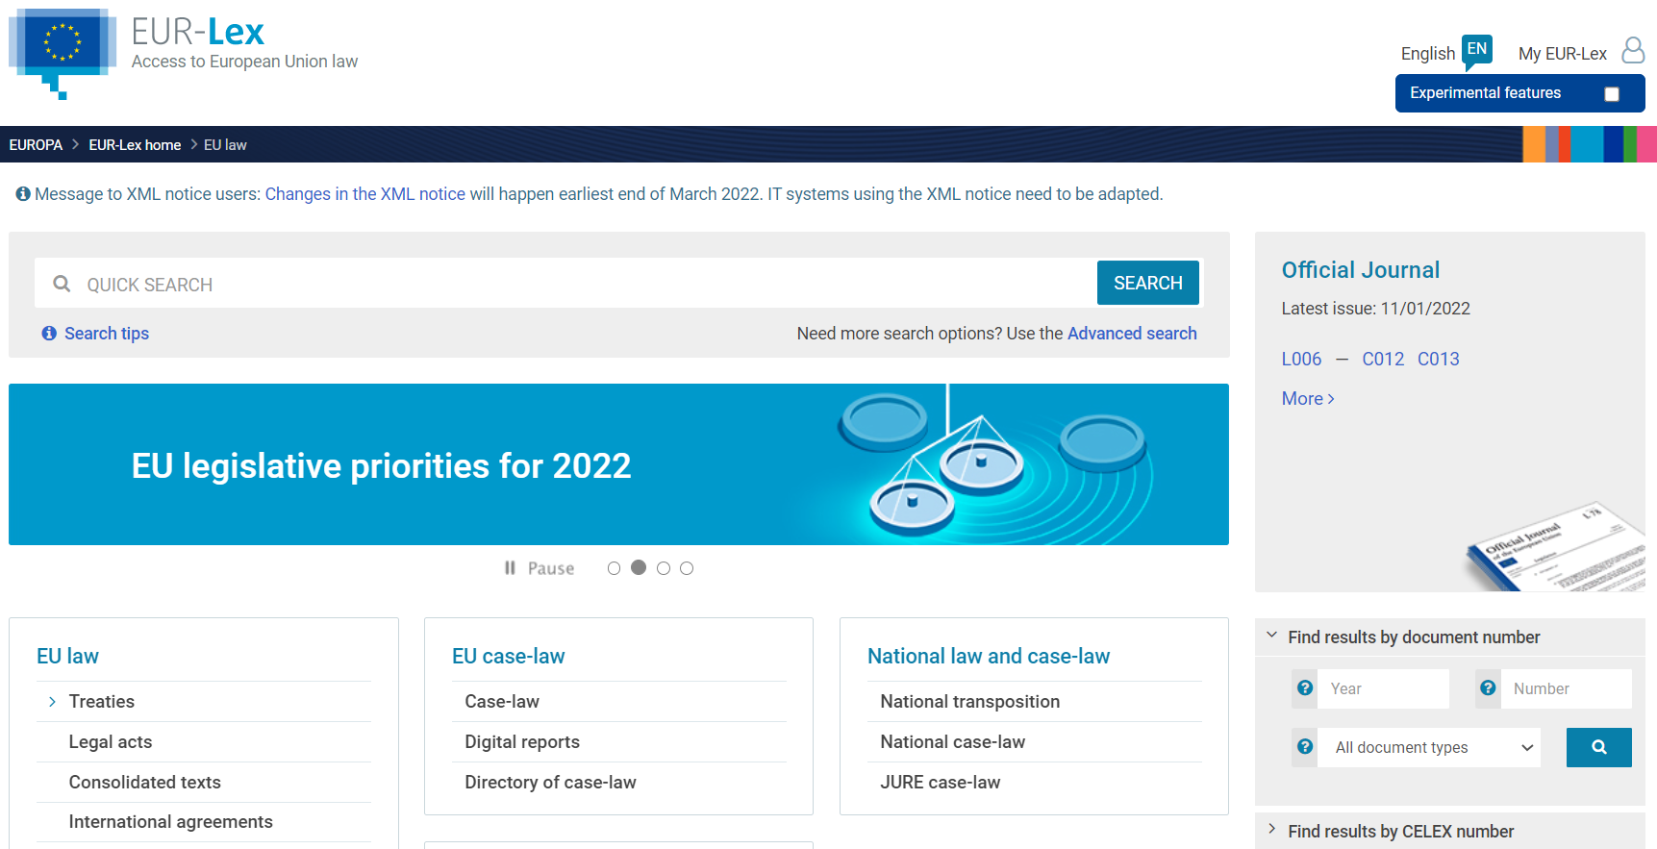
Official access to the EU directives and updates
https://eur-lex.europa.eu/

Slide 5
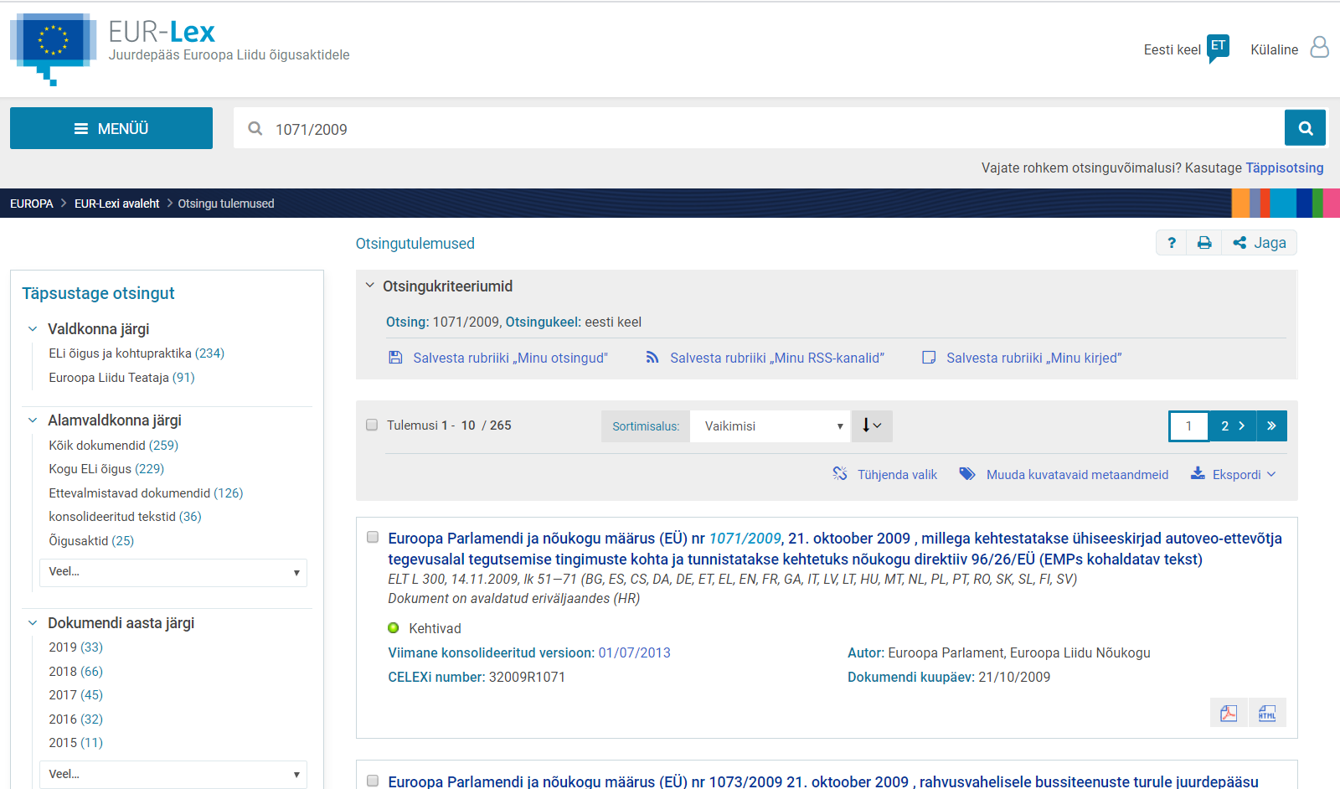
Official access to the EU directives and updates
https://eur-lex.europa.eu/

Slide 6
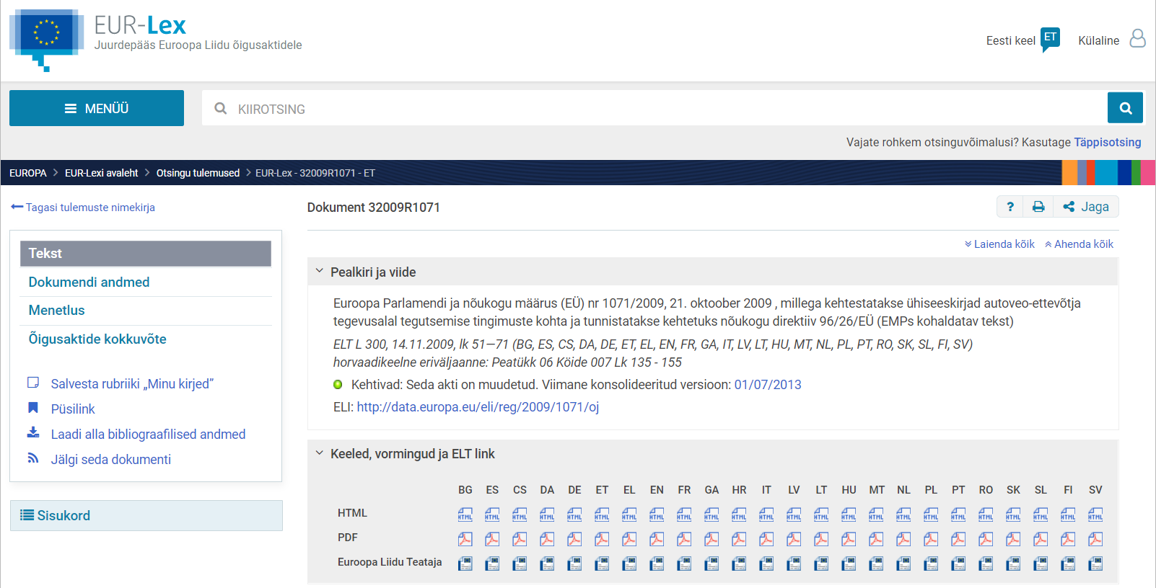
Official access to the EU directives and updates
https://eur-lex.europa.eu/

Slide 7
Official access to the EU directives and updates
EUR-Lex is online gateway to EU Law. It provides the official and most comprehensive access to EU legal documents. It is available in all of the EU’s 24 official languages and is updated daily.
There you can find the main types of EU legal acts: regulations, directives, decisions, recommendations and opinions. You can also search for certain other documents issued by EU institutions or bodies (for example communications of the European Commission, reports of the European Court of Auditors).

Slide 8
EU directives main areas
1071/2009 sets out the requirements for obtaining an operator’s licence in the EU. To qualify for an operator’s licence, operators need to be properly established, reputable, financially sound and professionally competent.
1072/2009 sets out the requirements for the use of goods vehicles travelling to the EU and permits the use of goods vehicles registered in the EU roads. That Regulation also currently limits the maximum number of allowed cabotage operations.
1073/2009 governs the access to the market for bus and coach operators. The regulation defines the different types of bus and coach service and the specific requirements they must fulfil to access the market.

Slide 9
Main purpose of the EU directive 1071/2009
The completion of an internal market in road transport with fair conditions of competition requires the uniform application of common rules on admission to the occupation of road haulage operator or road passenger transport operator (the occupation of road transport operator).
Such common rules will contribute to the achievement of a higher level of professional qualification for road transport operators, the rationalisation of the market and an improved quality of service, in the interests of road transport operators, their customers and the economy as a whole, together with improvements in road safety.

Slide 10
Main purpose of the EU directive 1072/2009
To ensure a coherent framework for international road haulage throughout the Community, this Regulation apply to all international carriage on Community territory.
This Regulation apply to the international carriage of goods by road for hire or reward for journeys carried out within the territory of the Community.
The establishment of a common transport policy, laying down common rules applicable to access to the market in the international carriage of goods by road within the territory of the Community, as well as laying down the conditions under which non-resident hauliers may operate transport services within a Member State.

Slide 11
Main purpose of the EU directive 1073/2009
To ensure a coherent framework for the international carriage of passengers by coach and bus throughout the Community, this Regulation apply to all international carriage on Community territory.
The establishment of a common transport policy laying down common rules applicable to the international carriage of passengers by road as well as the conditions under which non-resident carriers may operate national transport services within a Member State.

Slide 12
General view – carriage of goods for hire
Carriage of Goods by Road within the European Union
The carriage of goods by road using trucks with a gross vehicle weight exceeding 3,500kgs - HGVs - within the European Union is organised in two main categories:
For Own-Account - when carried goods are owned by the owners of the vehicles used to carry them;
For Hire or Reward - when carried goods are NOT owned by the owners of the vehicles used to cary them. This type of operation is normally referred to as Road Haulage.

Slide 13
General view – carriage of goods for hire
Carriage of Goods by Road within the European Union
The carriage of goods on own-account does not require any special permissions or licences and is therefore not regulated.
Road haulage within the European Union is regulated through Regulation (EU) No. 1071/2009 and Regulation (EU) No. 1072/2009.
Road hauliers must employ or engage a Transport Manager to effectively and continuously manage the transport operations, in line with Article 4 of Regulation (EU) No. 1071/2009.

Slide 14
EU directive 1071/2009 - Road transport operator
The occupation of road haulage operator’ means the activity of any undertaking transporting goods for hire or reward by means either of motor vehicles or combinations of vehicles;
The occupation of road passenger transport operator’ means the activity of any undertaking operating, by means of motor vehicles so constructed and equipped as to be suitable for carrying more than nine persons, including the driver, and intended for that purpose, passenger transport services for the public or for specific categories of users in return for payment by the person transported or by the transport organiser;

Slide 15
EU directive 1071/2009 - Transport manager
Transport manager is a person who is directly responsible organising a fleet operations in organisation and have a good reputation.
Transport manager needs to successfully pass an examination based on attendance of a specific vocational training course, which is mandatory for candidates not having an upper secondary school diploma.
The good repute of transport managers is conditional on their not having been convicted of a serious criminal offence or not having incurred a penalty, for a serious infringement, in particular relating to road transport.

Slide 16
EU directive 1071/2009 - Article 4
An organisation which engages in the occupation of road transport operator shall designate at least one natural person, the transport manager who:
1. effectively and continuously manages the transport activities of the undertaking;
2. has a genuine link to the undertaking, such as being an employee, director, owner or shareholder or administering it, or, if the undertaking is a natural person, is that person;
3. is resident in the Community.
in his or her capacity as transport manager, the person referred to in point (a) may manage the transport activities of up to four different undertakings carried out with a combined maximum total fleet of 50 vehicles.

Slide 17
Transport manager competences – road safety
Transport manager must, in particular, in relation to road haulage and passenger transport:
know what qualifications are required for drivers (driving licence, medical certificates, certificates of fitness, etc.);
be able to take the necessary steps to ensure that drivers comply with the traffic rules, prohibitions and restrictions in force in different Member States (speed limits, priorities, waiting and parking restrictions, use of lights, road signs, etc.);
be able to draw up instructions for drivers to check their compliance with the safety requirements concerning the condition of the vehicles, their equipment and cargo, and concerning preventive measures to be taken;
be able to lay down procedures to be followed in the event of an accident and to implement appropriate procedures to prevent the recurrence of accidents or serious traffic offences;
be able to implement procedures to properly secure goods and be familiar with the corresponding techniques; in relation to road passenger transport: 6
.have elementary knowledge of the layout of the road network in the Member States.

Slide 18
Community Licence for cargo and passengers transport
The directives stipulate that carriage of goods or carriage of passengers services may be offerred only if the transporter holds an operator licence for this purpose. This licence is issued by different authorities in different countries. For example in Estonia those licences are issued by Association of Estonian International Road Carriers (ERAA)
ERAA was founded in Tallinn on 30 October 1991. As from 1992 the Association is an active member of International Road Transport Union (IRU).

Slide 19
Community Licence for cargo and passengers transport
The main task of the ERAA, as laid down in its Constitution, is to promote the development of road transport and to protect its members interests and rights on national and international level.
The main activities of the Association are issuing permits to all the companies which have international road transport licences and giving out TIR Carnets to the companies accepted to TIR system. In Estonia ERAA is a guarantee organisation of international guarantee chain of TIR Convention.

Slide 20
EU directive 1072/2009 - Community Licence for cargo transport
The international carriage of goods by road should be conditional on the possession of a Community licence. Hauliers should be required to carry a certified true copy of the Community licence aboard each of their vehicles in order to facilitate effective controls by enforcement authorities, especially those outside the Member State in which the haulier is established.
The Community licence is issued by a Member State, in accordance with this Regulation, to any haulier carrying goods by road for hire or reward.

Slide 21
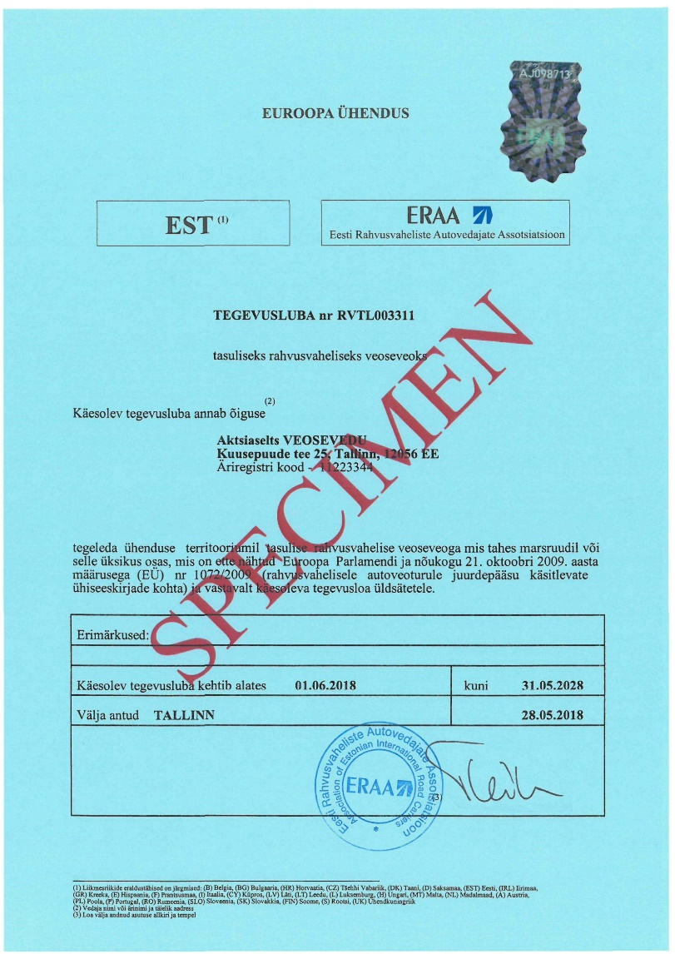
EU directive 1072/2009 - Community Licence for cargo transport – example

Slide 22
EU directive 1072/2009 - Community Licence for cargo transport – certified true copy
A certified true copy of a Community licence (hereinafter copy of the licence) is necessary if an operator wants to engage in the national or international carriage of goods for a charge using a motor vehicle or a combination of vehicles the permissible laden mass of which exceeds 3,500 kilograms and the design speed of which exceeds 40 kilometres per hour.
A certified true copy of a Community licence (hereinafter copy of the licence) certifies the right of the holder of the licence to engage in the carriage of goods for hire or reward using the motor vehicle bearing the registration number written on the copy of the licence.
A copy of the licence is issued for ten years, unless the applicant requests a shorter term, but not for a period longer than the term of validity of the licence.

Slide 23
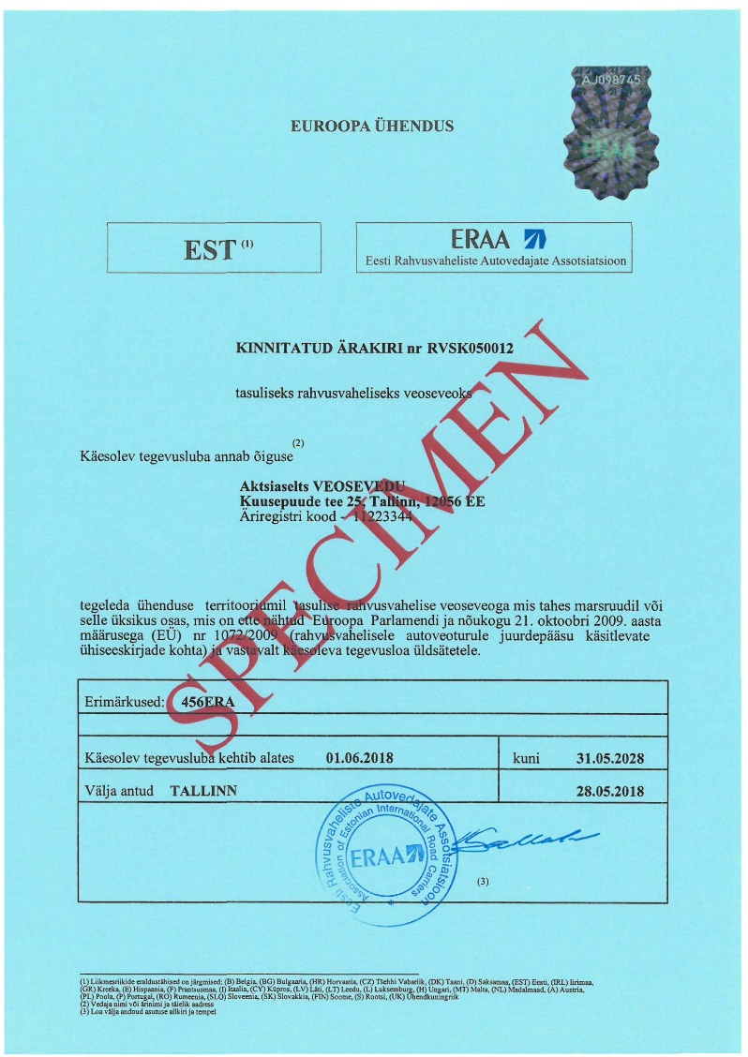
EU directive 1072/2009 - Community Licence for cargo transport – certified true copy - example

Slide 24
EU directive 1073/2009 - Community Licence for passengers transport
The international carriage of passengers by coach and bus should be conditional on the possession of a Community licence. Carriers should be required to carry a certified true copy of the Community licence aboard each of their vehicles, in order to facilitate effective controls by enforcement authorities, especially those outside the Member State in which the carrier is established.
The Community licence shall be issued in the name of the carrier and shall be non-transferable. A certified true copy of the Community licence shall be kept in each of the carrier’s vehicles and shall be presented at the request of any authorised inspecting officer.

Slide 25
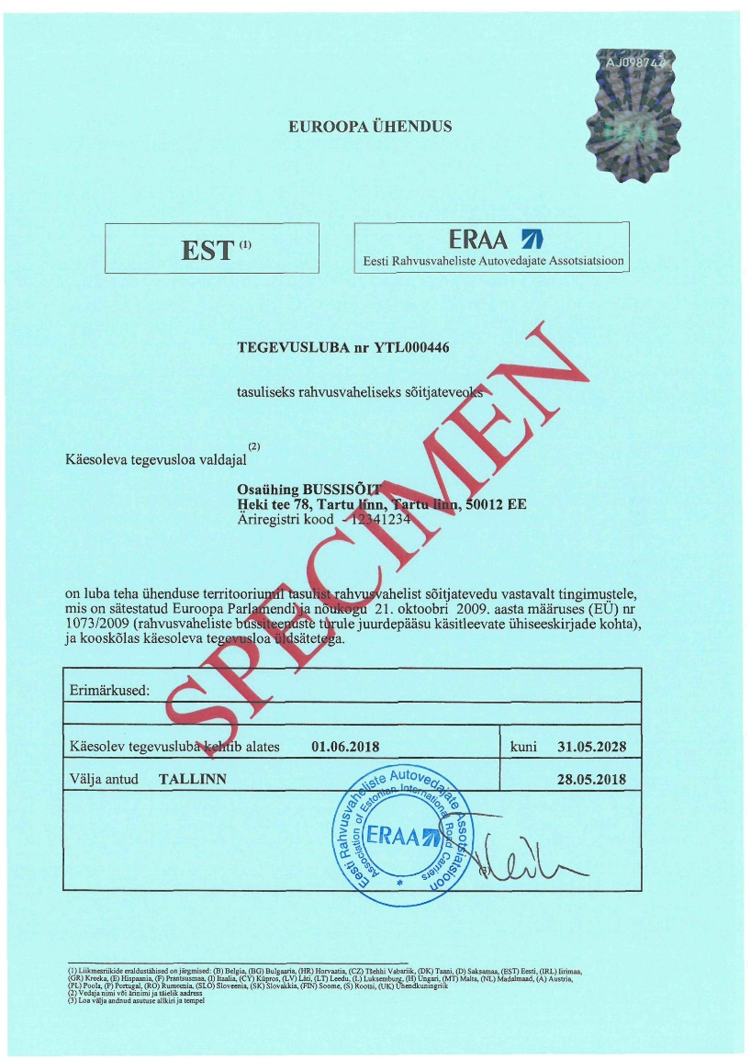
EU directive 1073/2009 - Community Licence for passengers transport - example

Slide 26
Next steps
Please find EU directives 1071/2009, 1072/2009 and 1073/2009 from your Moodle course under the sheet extra materials and read them through.
After this please fill the questionary at the end of the week 1 sheet as an self control purpose.

Slide 27
Thank you for your attention!
Interreg Central Baltic Project: INTELTRANS – Intelligent Transport and Traffic Management study module.

